Slide 1
Madhya Pradesh State Hemoglobinopathy Mission
State Experience in Sickle Cell Screening
Screening of Sickle Cell Disease (Methodology and Challenges)
23 – 24 October 2024
National Health Mission, Department of Public Health and Family Welfare, Madhya Pradesh

Slide 2
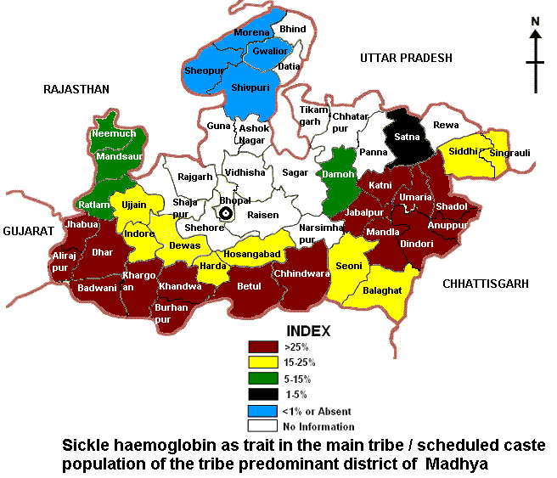
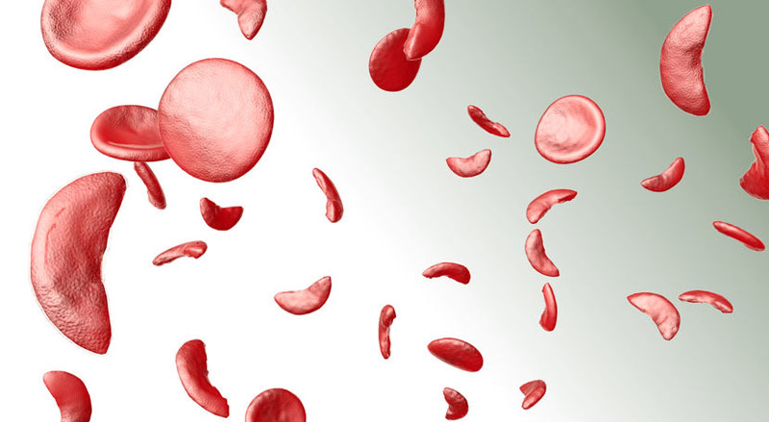
Disease Prevalence and Unmanageable SCD
What if SCD is not Managed
20% of children with sickle cell die within 02 years
30% of children from tribal communities suffering from SCD die before adulthood (ICMR survey-1989)
If appropriate interventions are not made, the number of sickle cell patients may increase due to genetic disease
The average age of sickle cell patients in India is 40-45 years
Prevalence of abnormal hemoglobin gene: about 0.7% of the population Prevalence: Sickle carriers - 5 to 33%, sickle disease 0.3-3.4% (as per ICMR Jabalpur 1989 survey) Most affected tribal-dominated districts - Alirajpur, Betul, Shahdol, Mandla, Chhindwara, Barwani, Dhar, Jhabua

Slide 3
Target Geography - Districts identified for sickle cell screening
13 Districts under PM JANMAN
Districts with 89 Tribal Blocks
Total 33 District
1 | Ashoknagar
2 | Bhind
3 | Datia
4 | Guna
5 | Gwalior
6 | Jabalpur
7 | Katni
8 | Morena
9 | Narsinghpur
10 | Raisen
11 | Satna
12 | Shivpuri
13 | Vidisha
1 | Alirajpur
2 | Anuppur
3 | Balaghat
4 | Barwani
5 | Betul
6 | Burhanpur
7 | Chhindwara
8 | Dhar
9 | Dindori
10 | Jhabua
11 | Khandwa
12 | Khargone
13 | Mandla
14 | Narmadapuram
15 | Ratlam
16 | Seoni
17 | Shahdol
18 | Sheopur
19 | Sidhi
20 | Umaria

Slide 4
Roadmap of State Hemoglobinopathy Mission Prioritizing SCD Screening and Management
Pilot Intervention
Pilot project launched in Alirajpur and Jhabua districts on 15 November 2021.
02
Inception
01
On June 2021, the State Hemoglobinopathy Mission was established in the state.
Facility Strengthening
04
Strengthening of health facilities for sickle cell anemia in Madhya Pradesh (Lab Diagnostic, Treatment Facility)
Budget Inclusion
03
Provision in state budget for screening and management of sickle cell patients.
Pilot Completion
Screening of pilot project completed in Jhabua and Alirajpur districts on July’22.
06
05
Data Managament
Scale up
Creation of Sickle Cell Portal for digital health record maintenance of sickle cell patients.
Under the second phase, screening and management work will continue in 89 tribal dominated development blocks
07

Slide 5
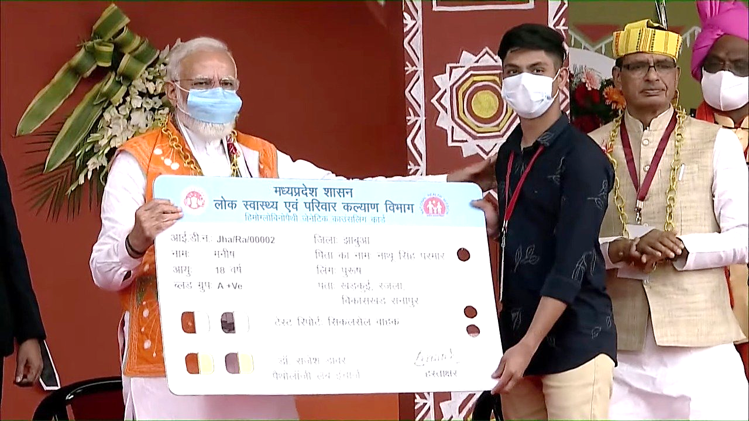
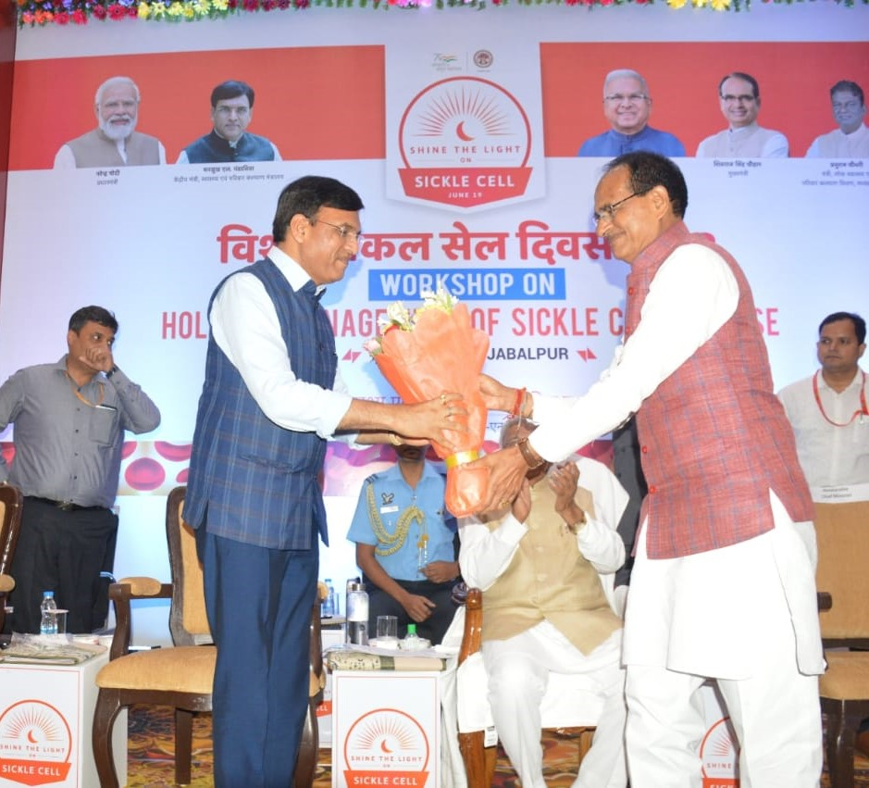
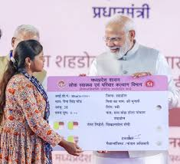
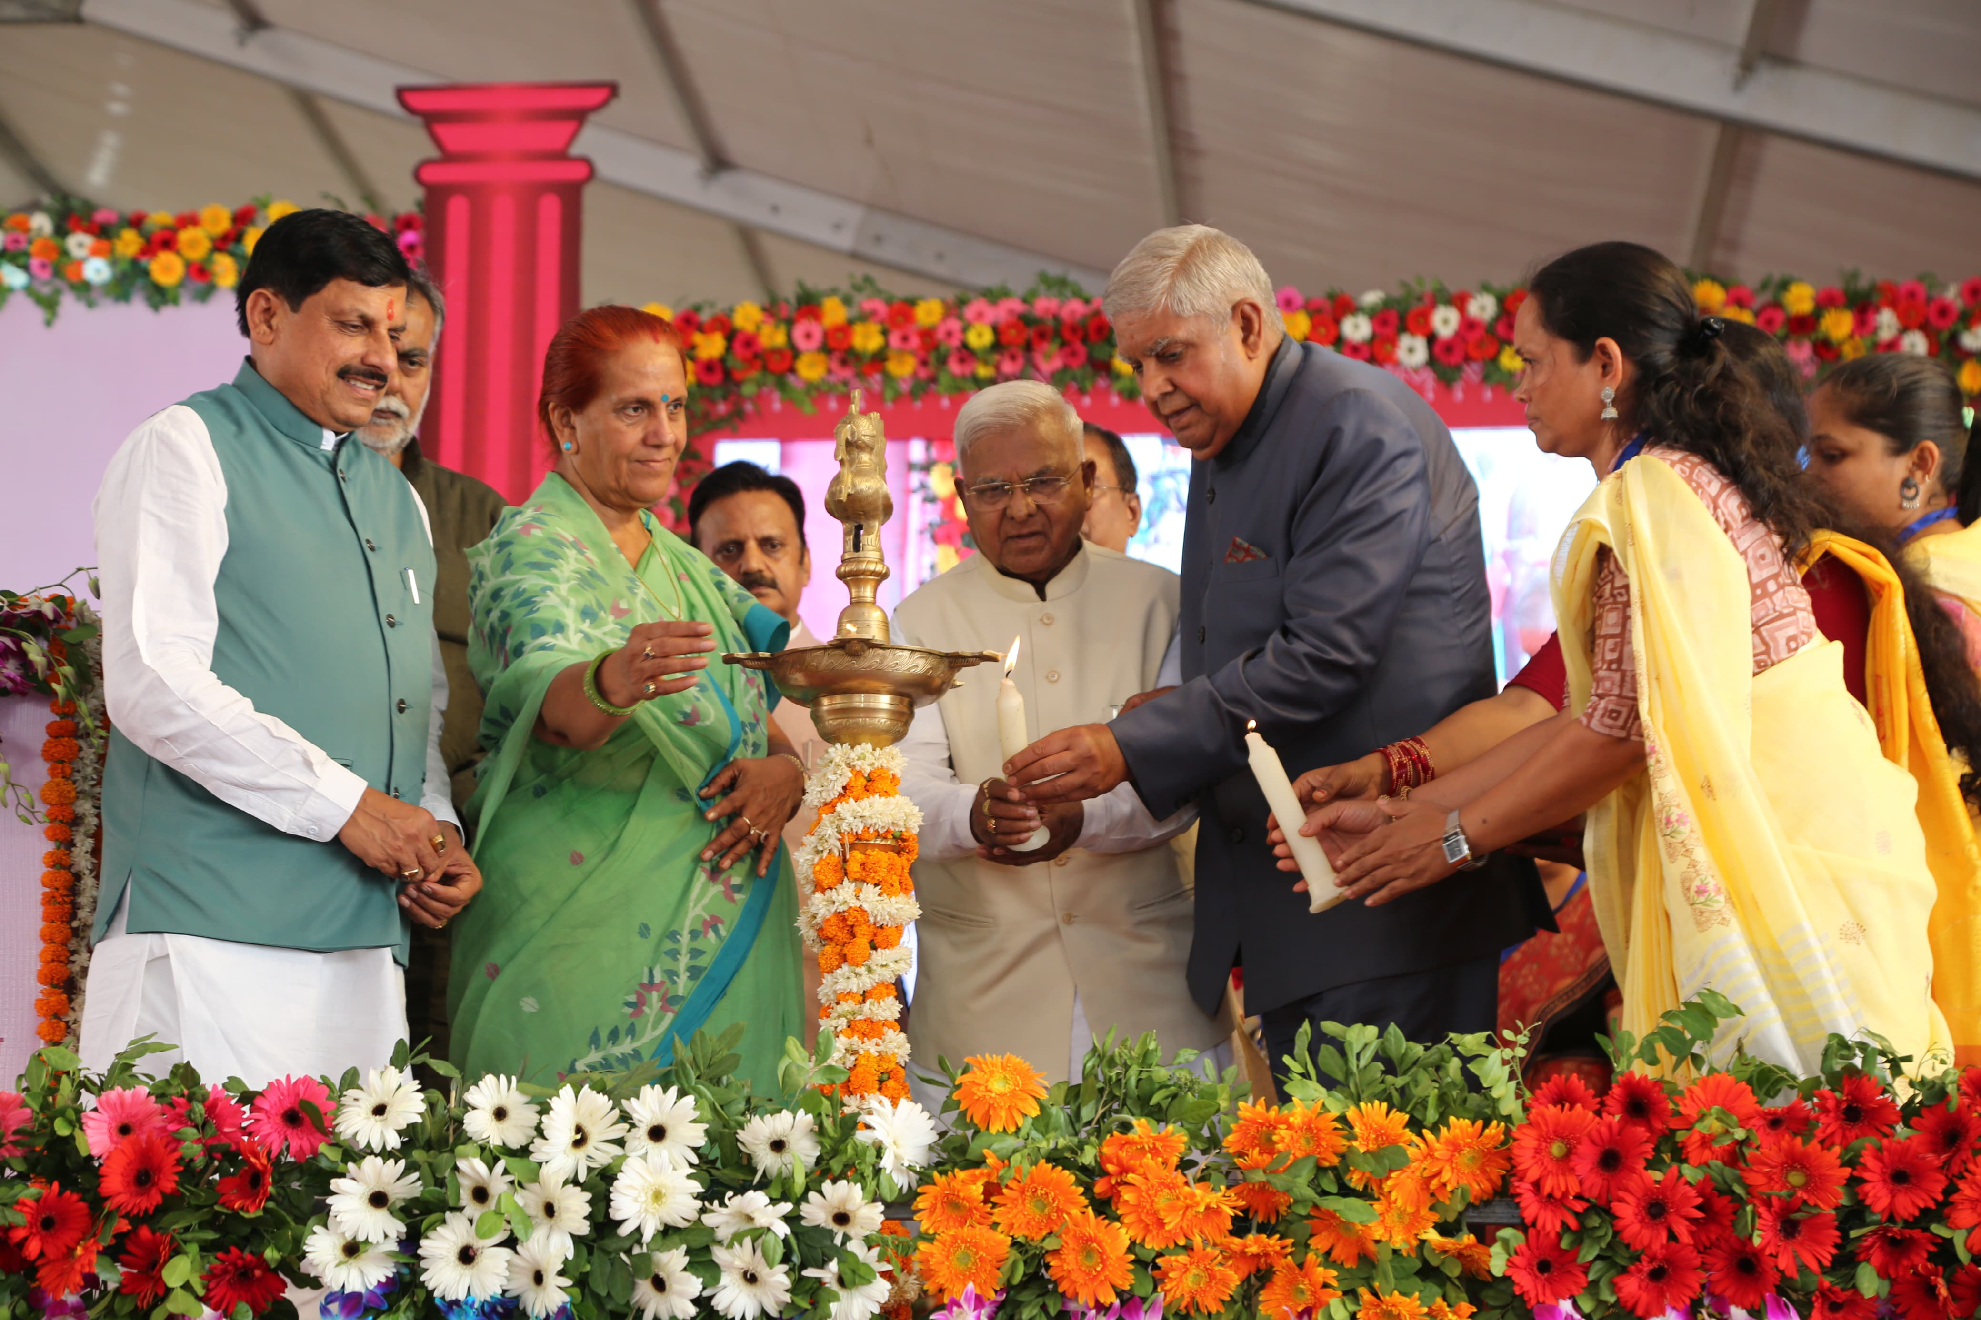
GOI focused State in addressing Sickle Cell Disease through segmented approach
15th Nov 2021
19th Jun 2022
1st July 2023
19th June 2024
A pilot project launched by the Hon’ble Prime Minister for screening in Jhabua and Alirajpur district of M.P
On World Sickle Cell Day, the Hon’ble Union Minister of Health and Family Welfare, inaugurated the Workshop on “Holistic Management of Sickle Cell Disease (SCD)” at ICMR-NIRTH
The National Sickle Cell Anaemia Elimination Mission was launched by Hon'ble Prime Minister at Shahdol, Madhya Pradesh
Hon’ble Vice President addressed the State-level World Sickle Cell Day in Dindori district of MP

Slide 6
Comprehensive Sickle Cell Management under State Hemoglobinopathy Mission (SHM)
To carry out genetic counseling to prevent the spread of hemoglobinopathy in the next generation.
To motivate for a healthy lifestyle by creating community publicity and awareness about hemoglobinopathy.
To reduce the cases of morbidity and mortality by screening sickle cell anemia at the community level and ensuring early detection and treatment after confirmatory tests at the institutional level.
Missions Objective
Public Awareness
Screening
Counselling
Management
Creating a conducive environment for public awareness
Screening of people of target age group and group
On-spot investigation Check-up at district hospital
Genetic counseling and distribution of cards of the respective group
Disease treatment- Medicines, blood transfusion vaccination, bone marrow transplant and consultation

Slide 7
Screening Action Plan and Process Flow for comprehensive disease management
Institutional Screening (OPD & ANC)
Community level door to door screening
Screening +ve Screening -ve
Screening
Sample Collection (03ml Blood) Store samples in cold boxes and transport them to the district hospital for confirmatory checks Entry in the sickle cell portal
Sampling
Data Entry
Screening negative/positive reports and entries in the portal
Genetic Card
Printing of Genetic Card
Counseling
Card Distribution and Genetic Counselling
Free treatment, management and blood transfusion, high risk pregnancies in Integrated Treatment Center / Day Care Center (RCH Portal Entry)
Management

Slide 8
Key achievements of SHM in 2024
Services
Interventions
Impact
Diagnostics
1
Provisioning of POCTs across the the State. The State has allocated budget in 2024 to the districts for POCT procurement
The state allocated 40 Cr for POCTs
Comprehensive Care
2
End-to-end approach for patients with appropriate counseling, treatment services and follow up care
SCD services extended till HWC level
3
SHM has prioritized newborn screening in the focused districts with aligned infrastructure and trained staff
~5000 screenings done till date
Newborn Screening
Pre-Natal Screening
4
With appropriate logistics and prepared infrastructure, prenatal screening has been initiated in the State
~18000 Nos of prenatal screening (PND) done
5
Towards the preventive management, the department has initiated the inclusion of Pneumococcal vaccines for the targeted age group
~25000 vaccines procured for 0-20 yrs
Immunization

Slide 9
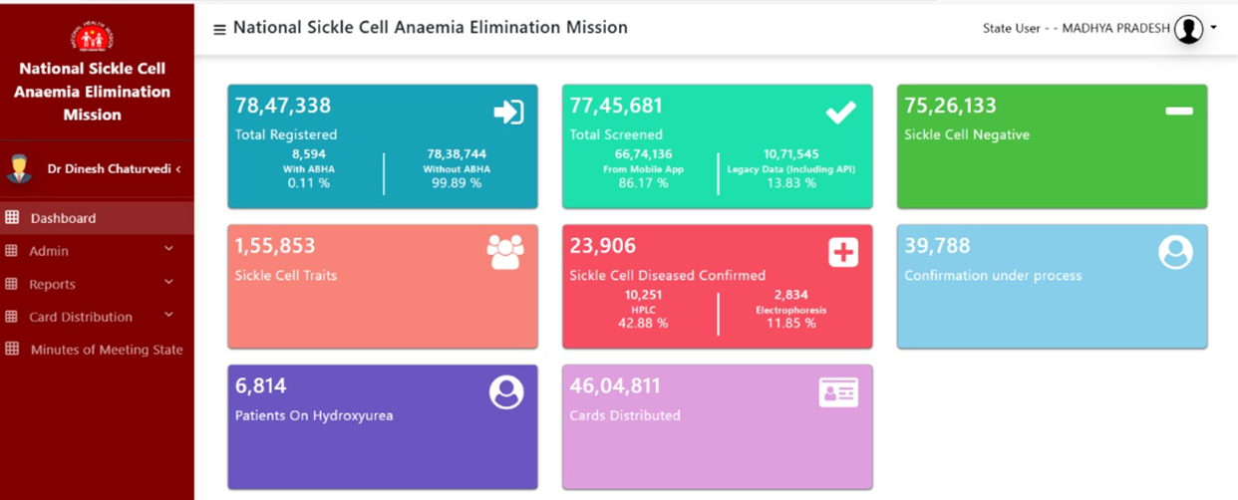
Status of Sickle Cell Screening as per the State portal till date

Slide 10
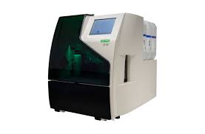
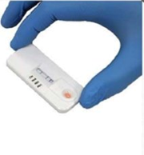
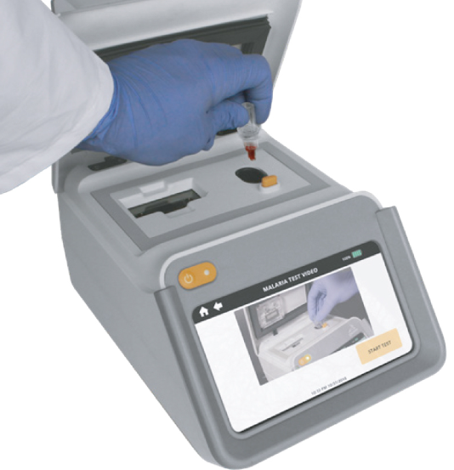
Sickle Cell Screening Methodology
Screening Test
Point of Care Tests
Lab-based Diagnosis
Molecular Tests
1
3
3
4
Solubility test
POC Sickle Scan
HPLC
PCR-based Test
Tests done in fields for screening only
Can not differentiate SCD and carrier
Based on lateral flow chromatographic immunoassay
Indicates the presence of Hb type
Can differentiate AS with SS
HPLC is sensitive, specific, and reproducible
Can also detect multiple variants in a single test
Confirmatory tests
PCR based tests
DH/Tertiary level institutes

Slide 11
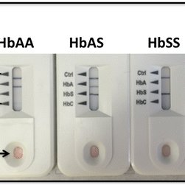
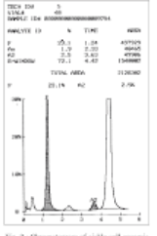
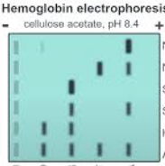
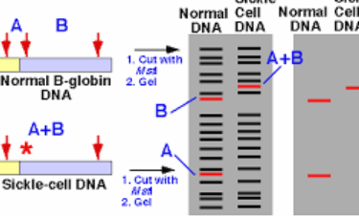
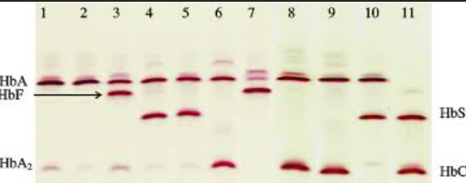
Technological Advancement in Sickle Cell Screening
POC Testing
Hemoglobin Electrophoresis
Isoelectric Focusing(IEF)
DNA Analysis
High-Performance Liquid Chromatography
Laboratory method that can be performed under alkaline or acidic conditions
Standard for Newborn Screening, diagnosis is possible with very small sample volume
To detect the mutations in β globin that produce abnormal Hb
Lateral flow immunoassays
Identify the various hemoglobin types in a blood sample
01
02
03
04
05

Slide 12
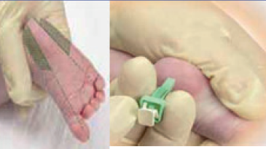
Specific Screenings
Newborn Screening
Prenatal Screening
Universal and Targeted Screening all consecutive newborns screened and Selective groups screened
The method of choice is first-trimester prenatal diagnosis by chorionic villus sampling at 10 to 12 weeks of gestation and DNA analysis.
Blood Samples for Newborn Screening
Heel prick samples
Cord blood samples
Second trimester - Amniocentesis at 14–15 weeks gestation and DNA analysis or fetal blood sampling by cordocentesis at 18 to 19 weeks gestation and HPLC analysis of the fetal blood to look for % of adult and sickle hemoglobin present.
Technologies for newborn screening includes Iso electric focusing/HPLC/Capillary electrophoresis & POC Testing. Confirmation of Diagnosis - Using a second method / DNA analysis
Routine blood investigations like Complete blood count, HIV, HBs Ag, HCV & Urine examination (at each consultation)

Slide 13
Learnings, scale-up of pilot and expansion
Targeted Pilot
Expansion of pilot intervention
01
Target District
01
Project expansion in the 89 blocks of the State
Alirajpur and Jhabua
02
Under the leadership of the Hon’ble Governor of MP and the results of pilot projects, the GOI launched the Sickle Cell Control Program along with State portal
02
Population
~8.26 Lakhs
03
• Target Age Group – 40 years • Population – ~1.5 Crs
• Target Districts – 20 • Project Duration - 02 Years
03
Target Group
06 months to 18 years and PW
In the expansion mode, technological advancement with doorstep screening with HPLC is done
04
04
Financial Provision
05
As a special campaign, an outsourced institution was selected for village-to-village screening
Funds recieved from Tribal Budget
05
Method of Investigation
For the screening and management of sickle patients, budget is allocated by the State government as well as from NHM
Solubility Test and HPLC
06

Slide 14
Efforts put-in and Challenges Faced in Pilot Intervention
Initiative
Intervention
Challenge
Intensive efforts in IEC development and deployment for mass awareness and accuracy in information with support from local NGOs
1
Observed gaps in capacity building of field staff to address community practices
IEC
FLW engagement and community mobilization at community platforms to address myths/misconceptions and hesitation
2
Technological glitches as there is a timelapse in confirmation of diagnosis
Community Mobilization
To address the specific needs of the community and gaps in service provisioning, corrective actions were taken with segmented approach and comprehensive disease management
3
Segmented Approach
Require high competency in diagnosis, high end skillset for HPLC interpretation
The program evolved with the advancement in screening technology and investigations infrastructure to cater the end-to-end approach in Sickle
Techno. Advancement
4
Rigid traditional beliefs and migration served as roadblock for treatment and follow up
Involvement of multiple stakeholders WCD, Education, Tribal, local NGOs and development partners etc. for efficient program delivery
Convergence

Slide 15
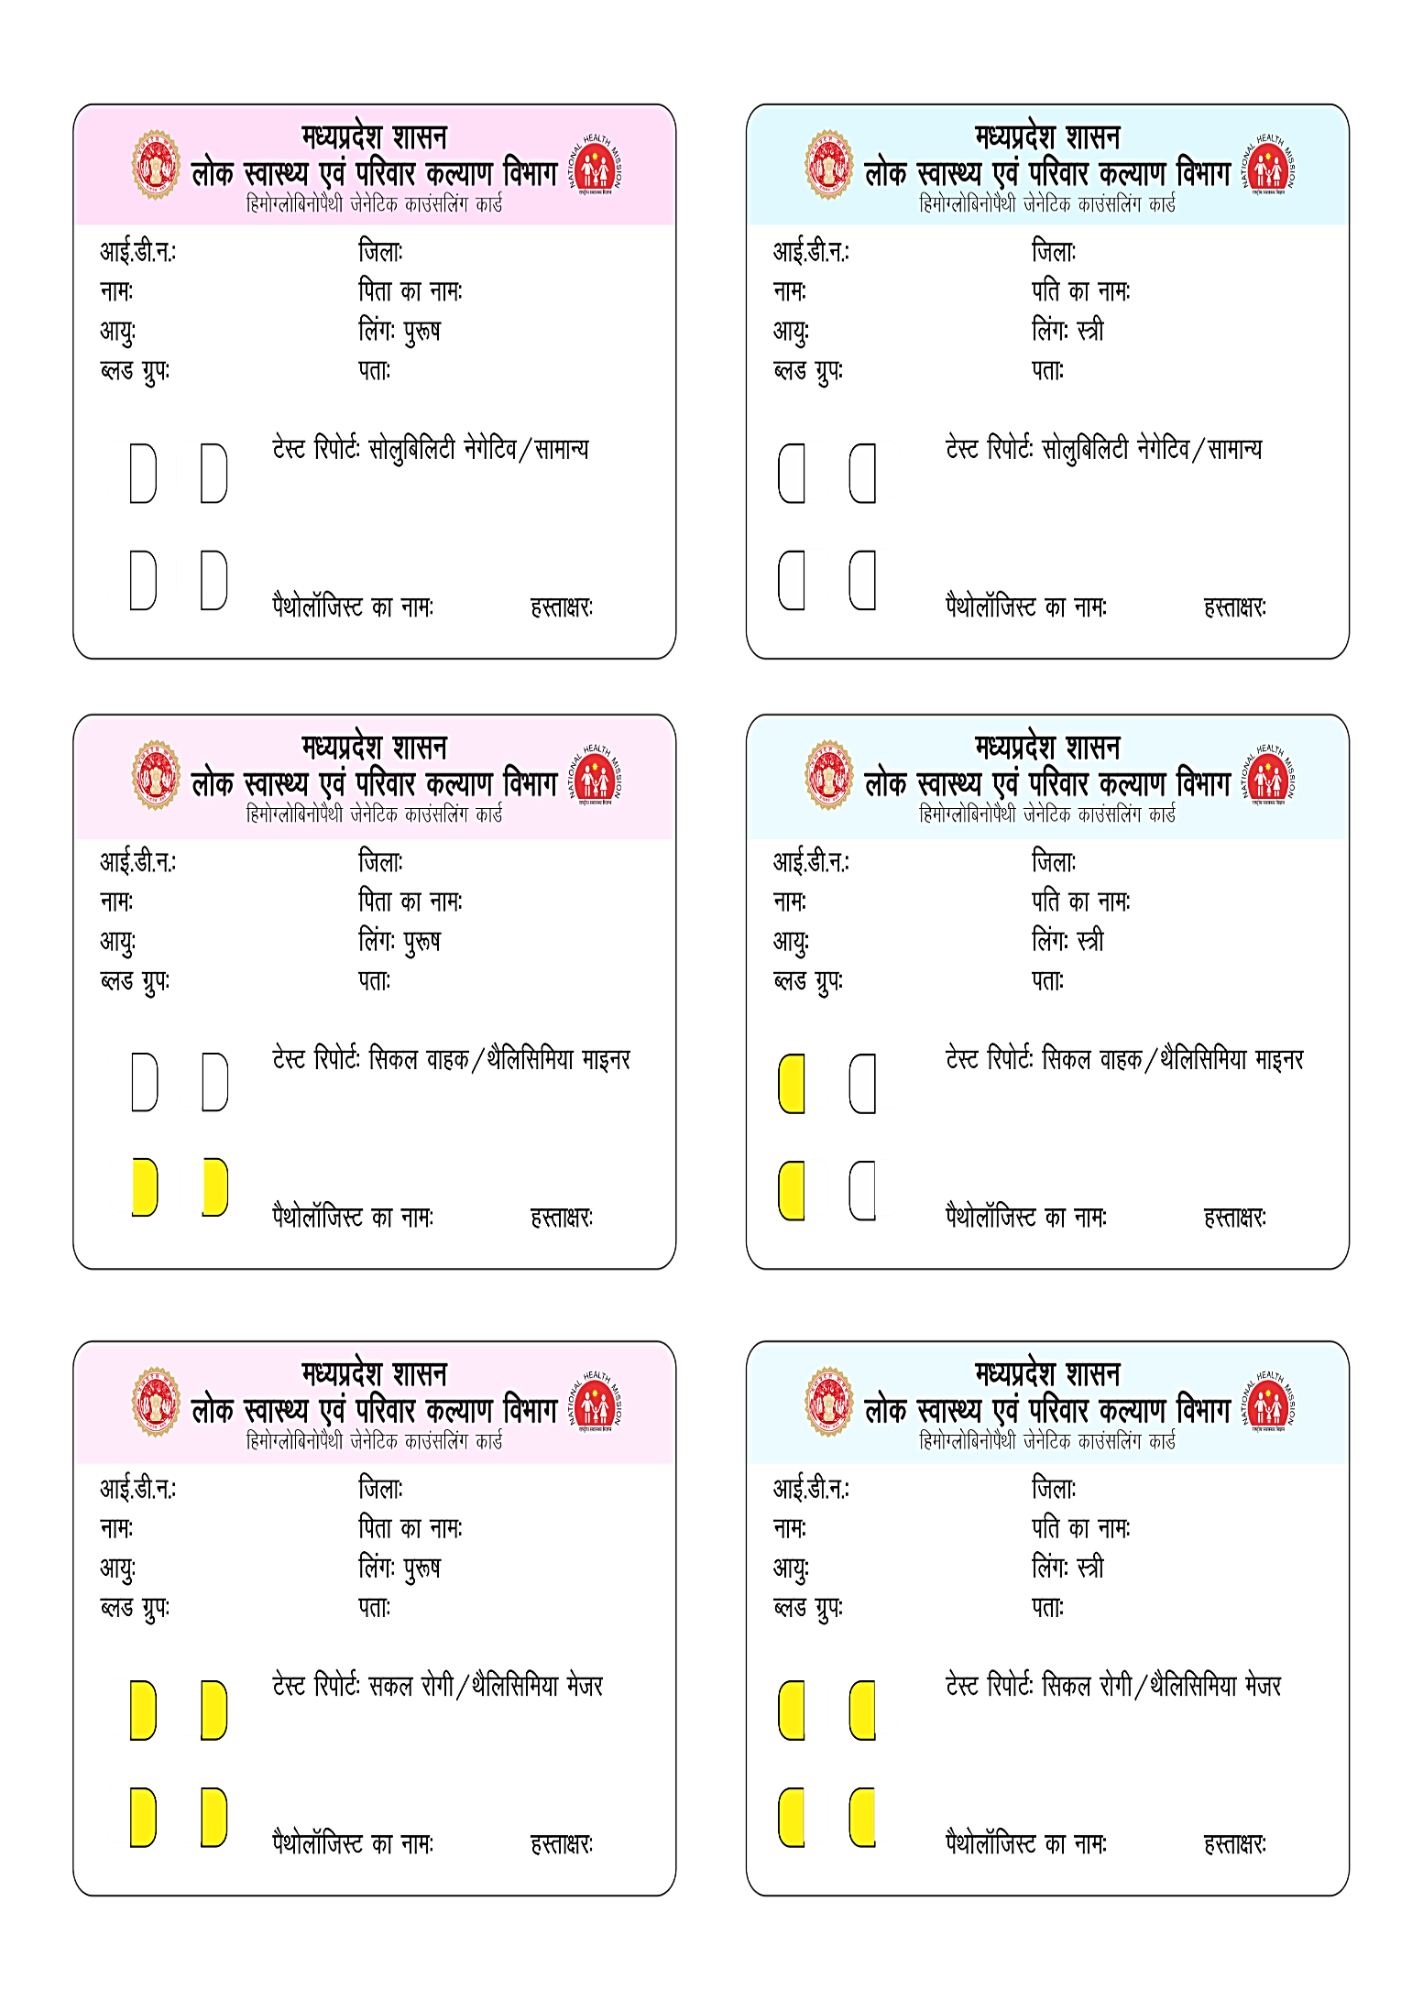
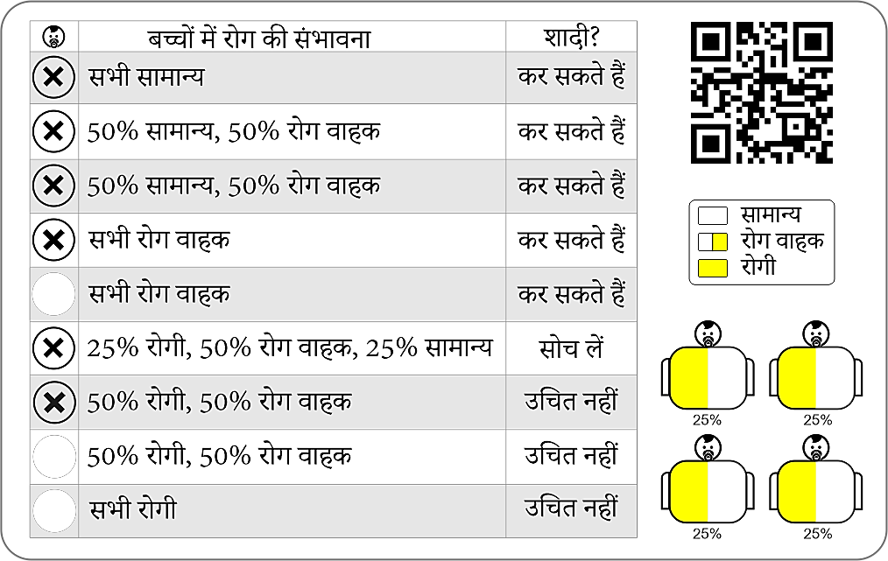
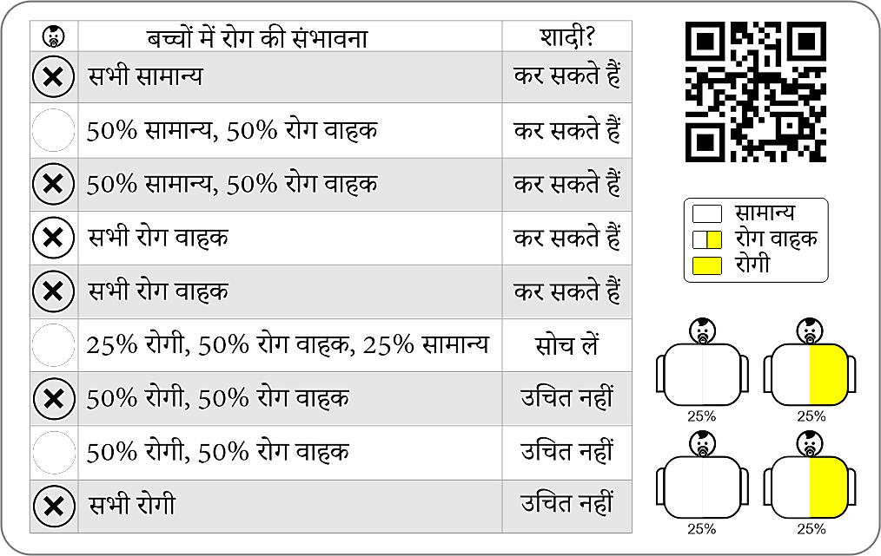
State initiative of Genetic Counseling Card distribution - playing a pivotal role in early detection and timely intervention
A sickle cell couple can recognize the possibility of the disease in their future child.
It is also playing an important role in family planning as well as awareness creation among tribes.
To date 46L have been distributed till date in the State

Slide 16
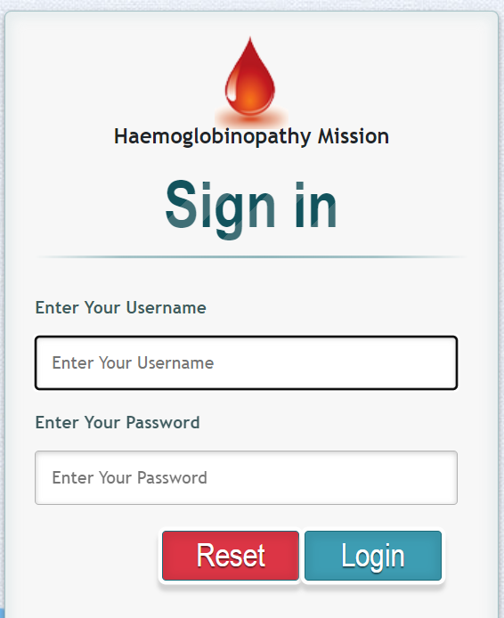
Integration of Sickle Cell Portal for Digital Health Records and State-level monitoring
1
2
Sickle Cell Portal is developed at national and state level for reporting, database and tracking of sickle cell screening.
Online entry and tracking of screening and confirmation checks at the community and institution levels.
4
3
Creation of digital health records of all sickle cell patients linking them with ABHA ID’s.
Under the Patient Registry Facility Module, information about patients screened by universities and other institutions is also being maintained.

Slide 17
MP Strategy for Sickle Cell Management
Screening
Sickle cell screening with POCT technology in 89 blocks tribal and further extended to across the state
Collaboration
Collaboration with AIIMS, ICMR for screening and investigations and demand generation/program support from Sankalp Foundation and JSS.
Under Dastak Abhiyan, sickle cell confirmed screening of identified children up to the age of 06 years in 89 tribal dominated development blocks. ~ children were screened for SCD during Dastak Abhiyan.
Focus on U5 Children
Capacity Building
ICMR Jabalpur completes district-level stakeholders training while Development Block Level (BMO, BCM) training in all tribal-dominated districts, is currently under process.
SOPs and Protocols
Developed SOP and treatment guidelines in collaboration with subject experts of AIIMS and ICMR at various institution and community level.
Availability
Provision of Essential Medicines (EDL) and Blood Transfusion for the management of all sickle patients found positive in screening.
Public Sector Strengthening
Impact in the public health sector strengthening with the inclusion of blood services, maternal health services, Health and Wellness Screening, physiotherapy in the State.

Slide 18
Additional efforts resulting in high-end quality of care for Sickle Cell Disease in MP
1
Under the leadership and efforts by the Governor of MP, all the state government universities have adopted 05-05 villages in tribal-dominated areas.
This will help in sickle cell Screening through volunteers and community awareness work.
Voluntary Contribution
2
Collaborated with Education Dept. for Screening and management of sickle cell in children studying in all tribal hostels and ashrams Phase-I. In Phase–II, Govt. educational institutes have started screenings.
In coordination with Defense, NCC Cadets are also involved in the SCD screening.
Involvement of Academia and Private Sector for the roll out of Screening.
Convergence
3
The Ministry of Tribal Affairs has approved 02 “Centre of Competence” (COC) Bhopal Memorial Hospital & Research Centre, Bhopal and MGM Medical College, Indore for the comprehensive treatment of SCD.
These COCs will provide high-end quality of care with pain clinics/Physio etc. in the SCD management.
Centre of Competence
4
State Haemoglobinopathy Mission has initiated Teleconsultation for SCD patients and family members towards add-on care.
Caregiver training will be further imparted to the family members for end-to-end care and follow up.
Care at the Doorstep
5
Targeted Screenings
Sankalp Foundation under the guidance of SHM, MP has screened ~18000 pregnant women in 13 districts of MP and further scaled-up to across the state in 51 districts.
6
Ensuring availability of Blood Transfusion services (~34000), Hydroxyurea (~17k patients retained on HU) and preventive therapy (Pneumococcal vaccines) for targeted age group.
Comprehensive Care

Slide 19
Overall challenges in Sickle Cell Management
Variation in the screening micro plan which needs to be strengthened for effective and increased screening.
Data management at the field level for screened patients needs to be simplified.
Channelizing communication of screening results to the patients is difficult.
Screening
Migration is still a concern for follow-up care and adherence to treatment regimen.
Screening, tracing, and follow-up of extended family members of SCD patients needs to be strengthened.
Delay by patients in reaching out during the crisis in SCD.
Follow-up
Strengthening genetic counseling via engaging local mentors and peer support.
Involvement of FLWs in household counseling and follow-up care.
Inclusion of Ayush/Yoga and other traditional methods for improving quality of life.
SCD Management
Capacity building of field-level service providers needs constant refresher for comprehensive counseling.
Segmented approach for addressing local challenges and roadblocks.
FLW Engagement

Slide 20
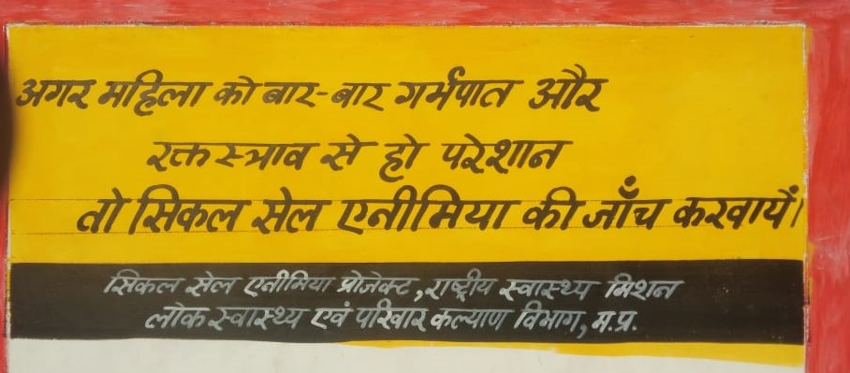
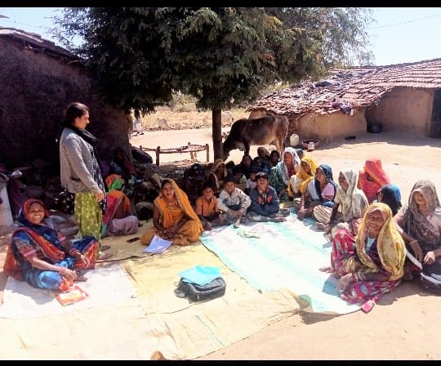
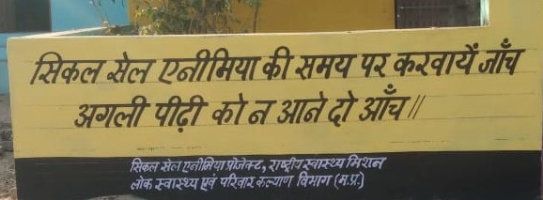
Community mobilization and public awareness by Jan Abhiyan Parishad

Slide 21
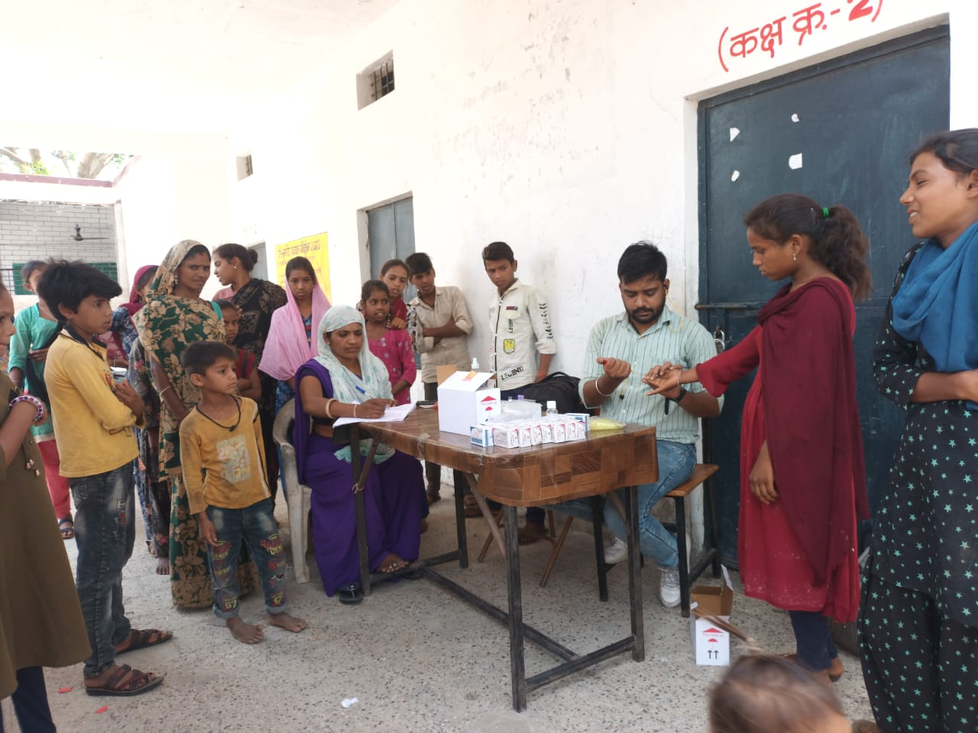
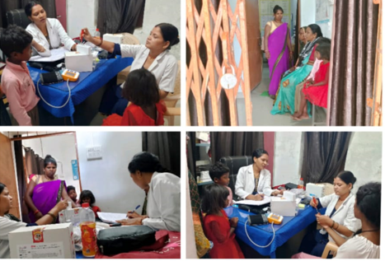
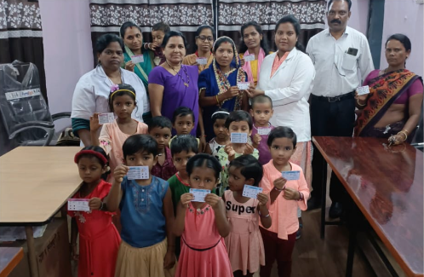
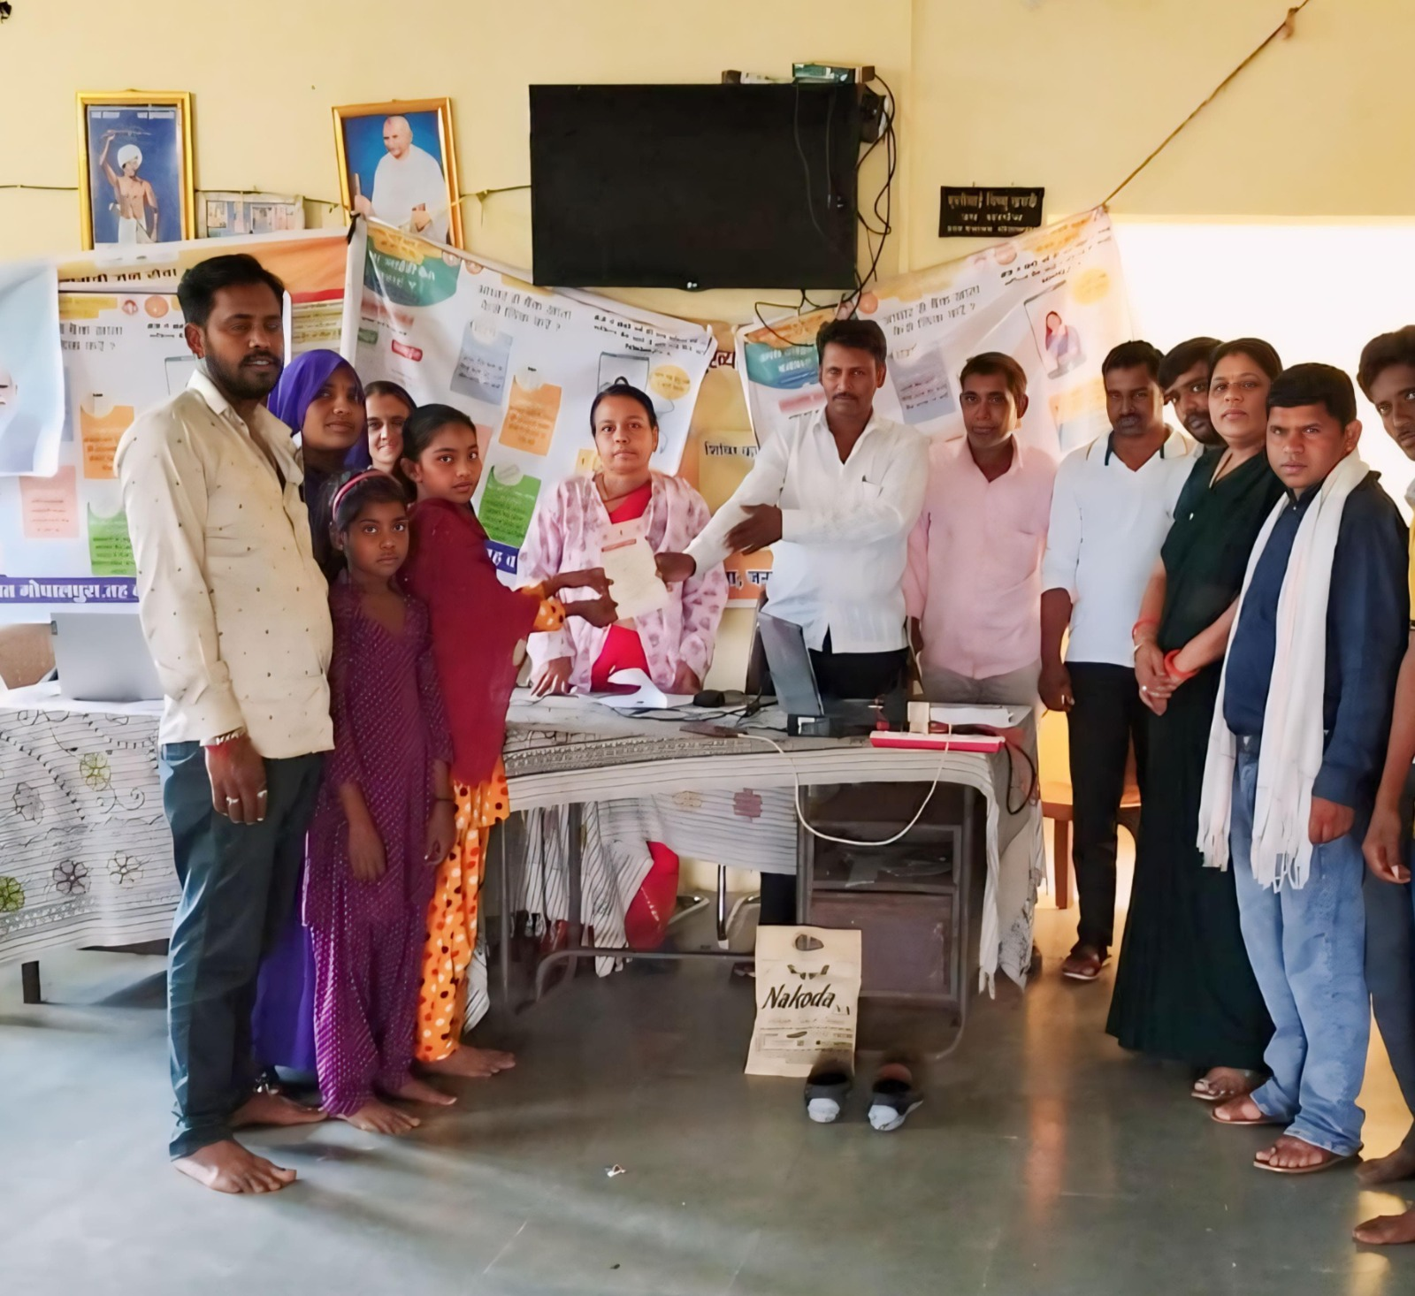
Field-level Screening and Community Mobilization
Targeted Screening at School
Facility-level Screening
Card Distribution
Card Distribution

Slide 22
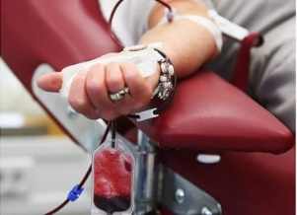
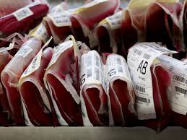
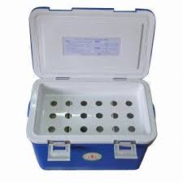
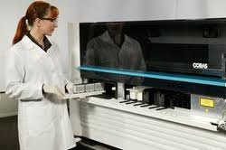
Comprehensive management by ensuring safe blood transfusion by VBD and NAAT tested blood availability
Blood collection in Barcoded vacutainers
Blood Bags ready to release
Result uploaded
Online
Pickup in Clod chain box and sample transportation
6 hours
4-5 hours
Testing in automated NAT PCR system

Slide 23
Thank you

